Slide 1
Machine Learning &
Breast Cancer Detection
Team Members:
Julian “Tarek” Hafza
Yao Li
Emma Smith
Gayle Murphy

Slide 2
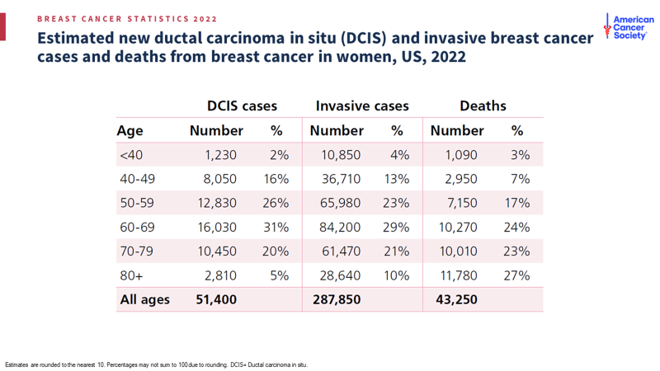
Understanding Breast Cancer
Breast cancer is the second most common cancer among women in the United States.
In 2022 alone, 287,850 new cases of invasive breast cancer will be diagnosed in women and 43,250 women will die from the disease.
According to the American Cancer Society, when breast cancer is detected early, and is in the localized stage, the 5-year relative survival rate is 99%.
This means that patients with malignant breast cancer that have not spread to other parts of the body are, on average, 99 percent likely to live 5 years beyond diagnosis.

Slide 3
Detection and Diagnosis
A mammogram is the most common screening test for breast cancer, it can be used to find breast cancer early, sometimes up to three years before a tumor can be felt.
Mammography can help in identifying cysts, calcifications, and tumors within the breast.
***Mammograms can help detect cancer, but they can’t diagnose cancer.
It can show abnormal breast tissue, and it helps healthcare providers decide whether further diagnostic testing, such as FNA is needed.

Slide 4
Data Source - Wisconsin Diagnostic Breast Cancer
This dataset contains measurements on cells in suspicious lumps in a woman’s breast.
The features are computed from a digitized image of a fine needle aspirate of a breast mass. They describe characteristics of the cell nuclei present in the image. All samples are classified as either benign or malignant.
***An FNA (fine needle aspiration) is a procedure that removes some fluid or cells from a breast lesion (a cyst, lump, sore or swelling) with a fine needle similar to that used for blood tests.
The dataset includes columns for data id, classification, and measurements for 30 features.
Our team’s objective is to train the model to see how they correlate with a classification of Malignant or Benign.

Slide 5
Model 1

Slide 6
Model 2

Slide 7
ML summary

Slide 8
Presentation summary

